Slide 1

Generative AI – Building a Secure and Local “Mini ChatGPT”
Personal Project & Portfolio
October 2023
By: Achmad Arviandito Caessara
Source: CNN

Slide 2
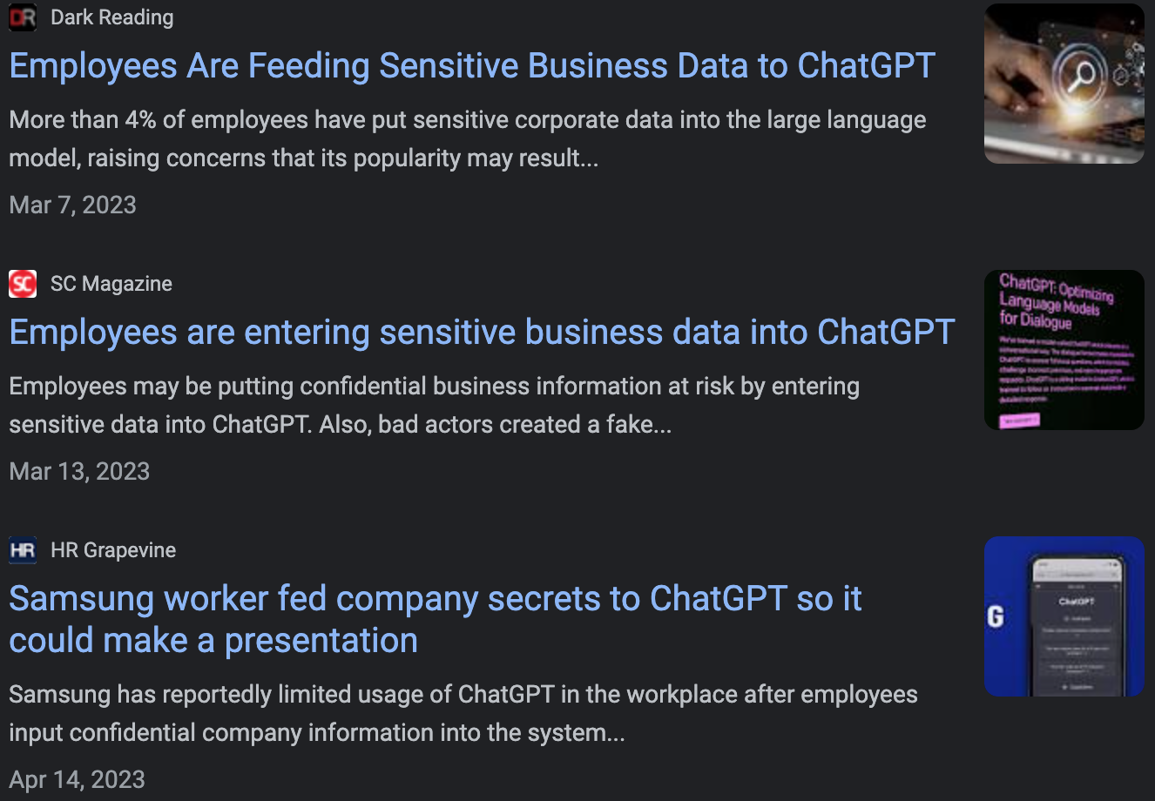
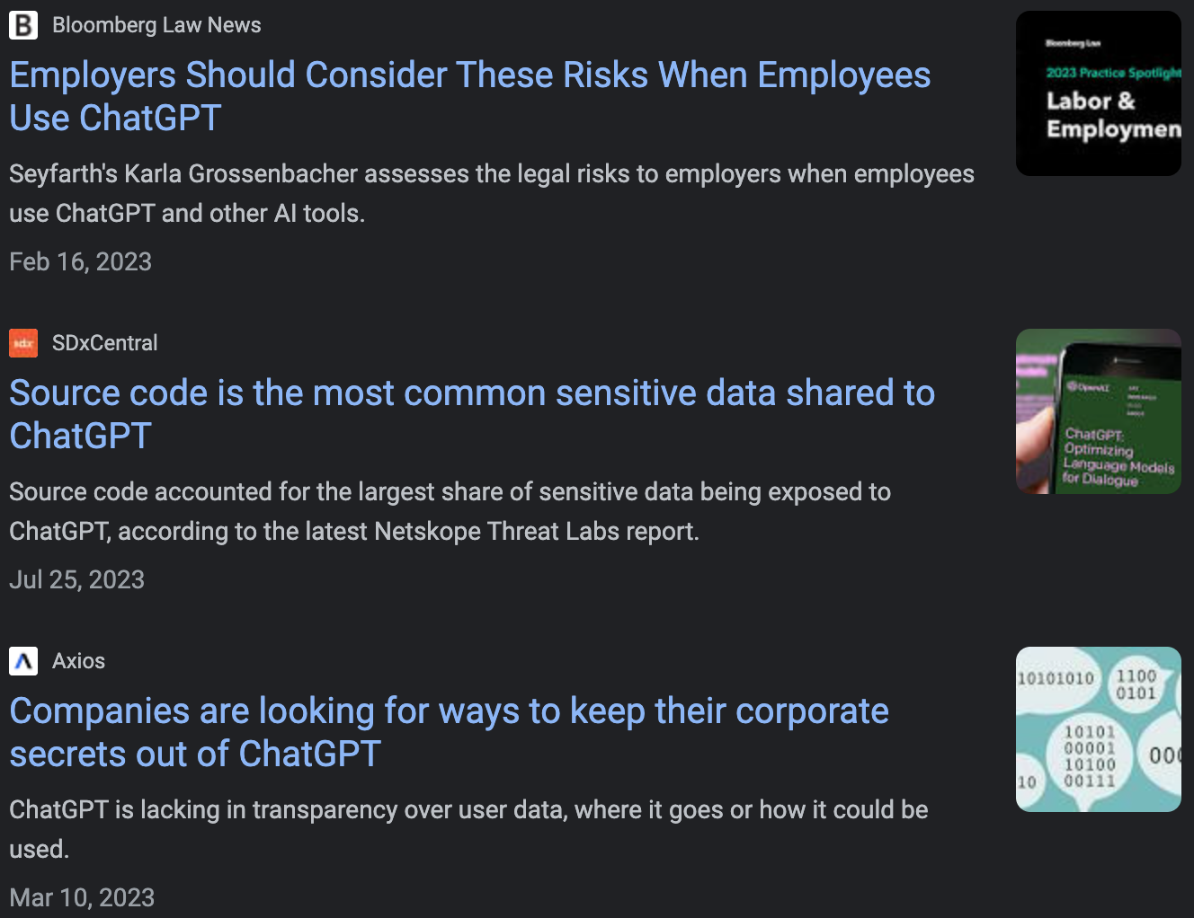
The project objective is to create a locally hosted and secure “Mini ChatGPT” to address the essential need for protecting sensitive data
1
Problem Statement
Problem Statement and Project Objective
Current situation
Needs
To address these concerns, we need to take several factors into consideration:
Develop our own model with features similar to the original ChatGPT
Train the model using our internal documents and database to incorporate “personalized” knowledge.
Ensure it operates within our local premises to prevent data leakage.
Confidential data should never be input into ChatGPT, as numerous cases have demonstrated instances where individuals input sensitive information, resulting in leaks of confidential data.
Nevertheless, generative AI models, such as ChatGPT, prove highly valuable in enhancing productivity and expediting task completion.
Therefore, this project aims to construct a simple model, referred to as "Mini ChatGPT," capable of being trained on our proprietary data and operated within our local environment
Source: Google News
October 2023
Generative AI – Text Generator

Slide 3
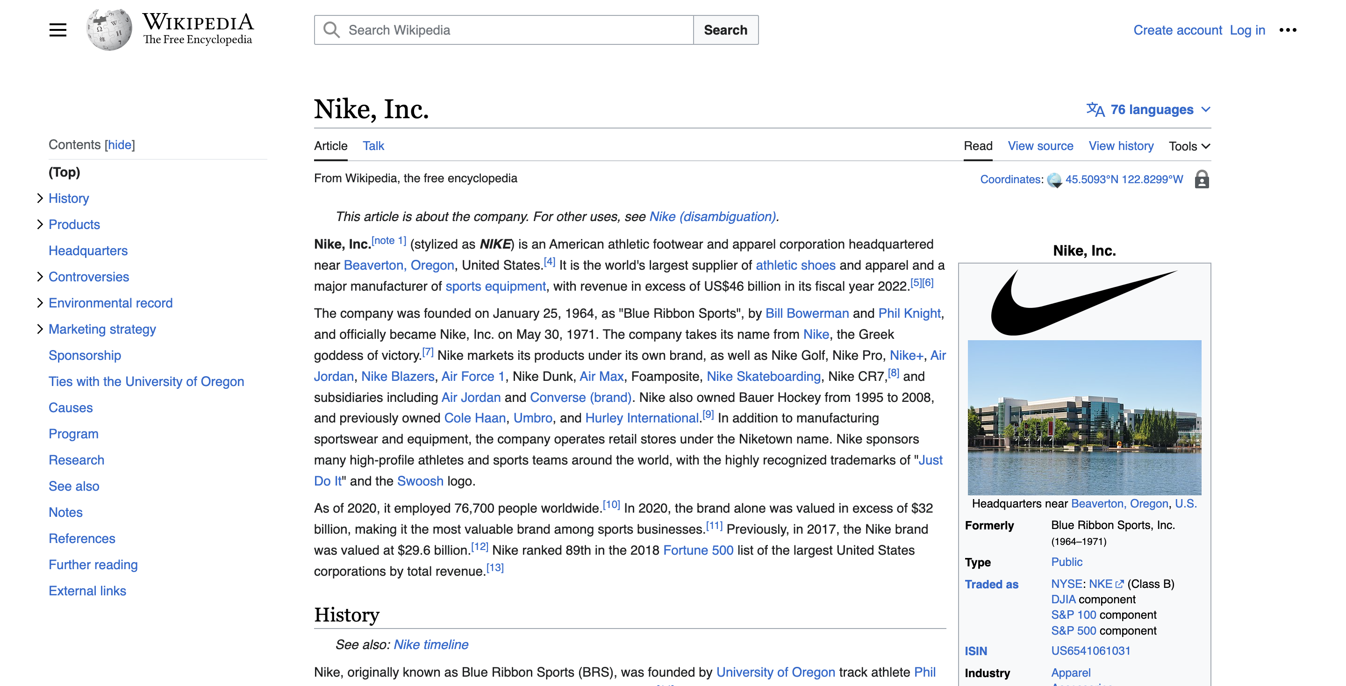
In this project, we leverage Nike information from the Wikipedia, followed by preprocessing the data into full-text and Q&A structures
2
Data Used
Data Utilized for Model Development
We will treat the Nike information as our "confidential data" and preprocess it into two types for training and fine-tuning purposes:
Full-Text (Training)
Contains 7,097 words in total with 2,780 unique words.
Question and Answer (Fine-Tuning)
We prepare 200 sets of questions and answers.
Note: You may try using any other data of your choice!
Source: https://en.wikipedia.org/wiki/Nike,_Inc.
Generative AI – Text Generator
October 2023

Slide 4





Using the Transformer library, tokenize the data, train initially with the full text, and fine-tune it in a Q&A format to have a chatbot-style model
3
High-level Flow
High-level Flow of Model Development
Data Preparation
Tokenizer
Train with Full-text
Fine-tune to
QnA format
Text Generator (chatbot-style)
In this project, there are five main steps, and only need to run four Python commands in the project files:
Data Preparation – Prepare the dataset, both the full text and Q&A, then standardize the format. -> run: $python data/prepare.py
Tokenizer – Tokenize every word using GPT2Tokenizer.
Train with Full-text – Train the model using the pre-trained model 'GPT-2' with defined parameters. -> run: $python train.py
Fine-tune to QnA format – Fine-tune the model to yield results in a question-and-answer format. -> run: $python fine_tune.py
Text Generator – Input a question then run the model to generate the answer. ->run: $python generate.py
Generative AI – Text Generator
October 2023
Notes:
Who is the NIKE CEO?

Slide 5
Several next steps to improve this model: tuning the parameters, utilizing a more training method, or experimenting with other libraries
4
Next Step
Next Step
1
To be completed
Update the parameter
2
Have a better engine
3
Add the step
4
Try other tokenizer, engine, etc
5
Try it yourself!
Generative AI – Text Generator
October 2023

Slide 6
Special acknowledgment to these incredible individuals who inspired the development of this project through their previous work
5
Acknowledgment
List of Acknowledgements
Daniel Guetta - Associate Professor at Columbia Business School / CBS, PhD
Andrej Karpathy - Sr. Director of AI at Tesla / Stanford, PhD
Sophia Yang - Sr Data Scientist at Anaconda / University of Texas at Austin, PhD
Sreenivas Bhattiprolu - Director of Digital Solutions at Zeiss / Michigan Technological Univ., PhD
Note: Please check their GitHub and YouTube channels for other amazing projects!
Generative AI – Text Generator
October 2023

Slide 7
Thank you !
Notes:
Who is the NIKE CEO?
How many employees did Nike employ as of 2016?
What is the most popular NIKE shoes?

